Slide 1
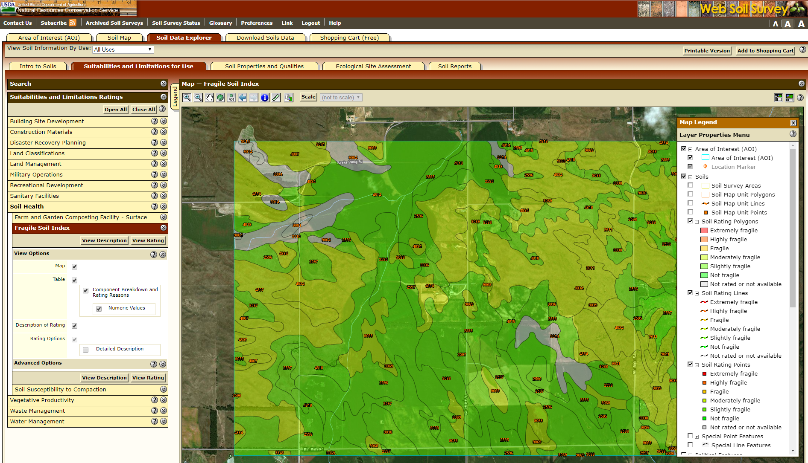
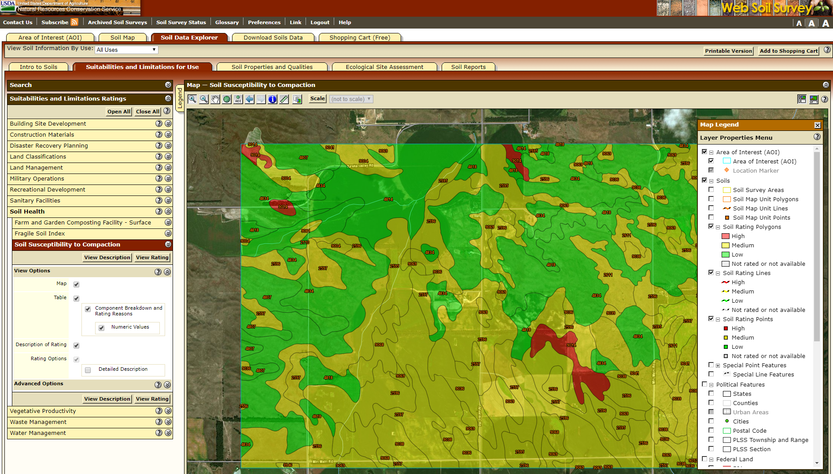
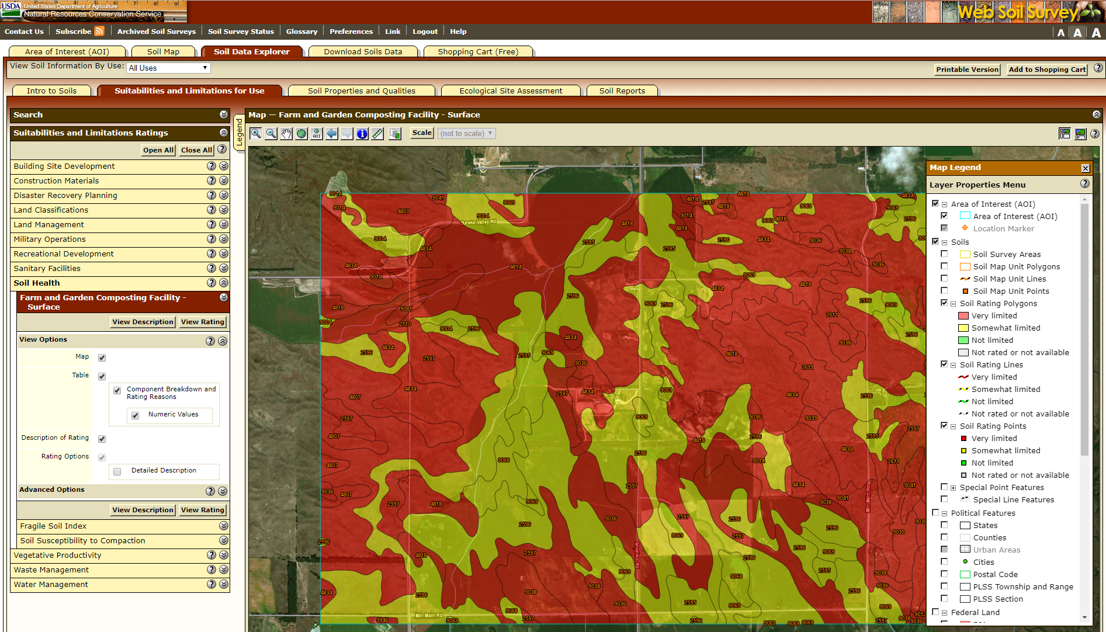
Soil Health Interpretations: Using soil survey data to inform soil health assessment and conservation planning
Diane Stott, Maxine J. Levin, and the Soil Health Interpretations Team (Cathy Seybold, Steve Campbell, Bob Dobos, Steve Peaslee, Wade Bott, Jennifer Moore-Kucera, Brandon Smith, Dana Ashford, Lindsay Haines, Charles Kome, Richard Reid)
ABSTRACT
Example map of Soil Health – Fragile Soil Index in Web Soil Survey.
Traditional soil survey is grounded in a soil-landscape model that identifies spatially contiguous map units at a farm scale (typically 1:24000) and estimates “representative values” for soil properties at the component level. Soil classification, especially US Soil Taxonomy which was developed in concert with soil survey, focuses on using soil properties and morphological characteristics such as sub-surface diagnostic horizons to define taxonomic groups. The primary goal of the soil survey/soil classification paradigm is to provide standard, largely categorical, information for farm scale management. In contrast, soil health has focused interest on dynamic soil properties defined as properties that can be changed through management at human time scales – months, years, or decades. Creating soil interpretations for soil health poses unique challenges due to the dynamic nature of the soil attributes that are used to assess soil health. Interpretations can assist in making predictions such as identifying soils with the highest potential to accumulate and store carbon or soils that would most benefit from specific cover crops. There are many interpretations that can be made based on soil survey data that can tell the user about the potential for improving soil health and other indicators of healthy soil. We will explore the building of criteria, thresholds, and potential of these soil interpretations for soil health. This presentation will use specific examples from the USDA NRCS Soil Health Interpretations Team projects to show soil survey information providing a framework to access the potential effects of management practices or suites of soil health related management practices that can be extrapolated beyond specific locations. Additional potential applications of soil survey data for conservation planning considering soil health related properties will also be discussed.
New Soil Health Interpretations on Web Soil Survey:
Suitabilities and Limitations
Soil Health
Farm and Garden Composting Facility – Surface (2017)
Fragile Soil Index (2017)
Soil Compaction (2017)
Soil Organic Matter Depletion (late 2018)
Concentration of Salts—Soil Surface (late 2018)
Soil Surface Sealing (late 2018)
Agricultural Organic Soil Subsidence (late 2018)
Suitabilities for Aerobic Soil Organisms- Habitat (late 2018)
Soil Properties and Qualities
Soil Health Properties
Organic Matter (2017)
Surface 1/3 Bar Bulk Density (late 2018)
Surface Available Water Capacity (late 2018)
Surface pH (late 2018)
Surface SAR (late 2018)
Surface Texture (late 2018)
Example map of Soil Health – Soil Susceptibility to Compaction in Web Soil Survey.
Example map of Soil Health – Farm and Garden Composting Facility – Surface in Web Soil Survey.
Natural Resources Conservation Service l Soil Health Interpretations Team l nrcs.usda.gov/soils

Slide 2
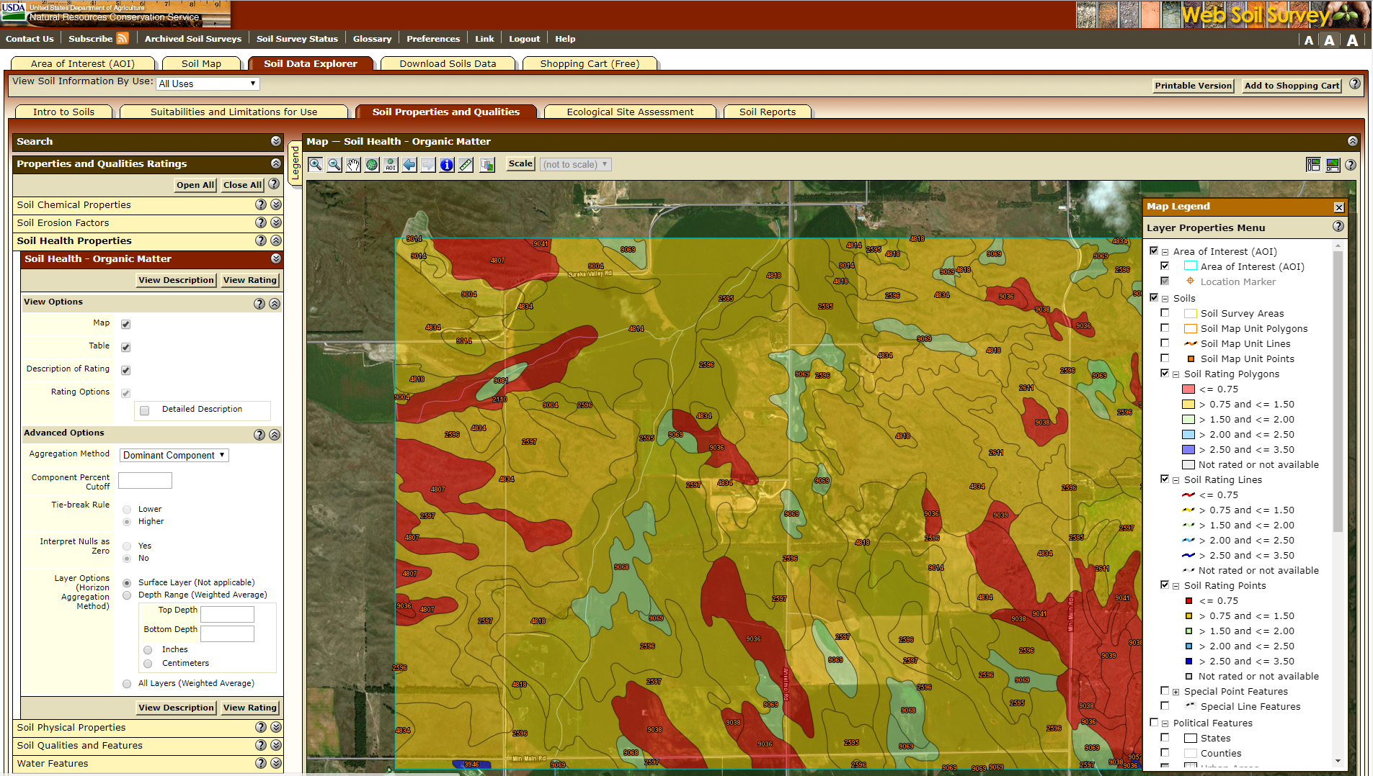
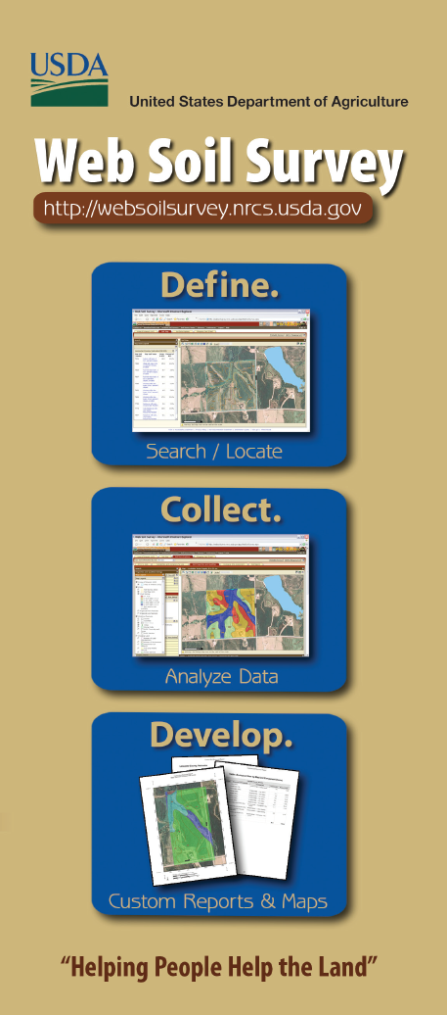
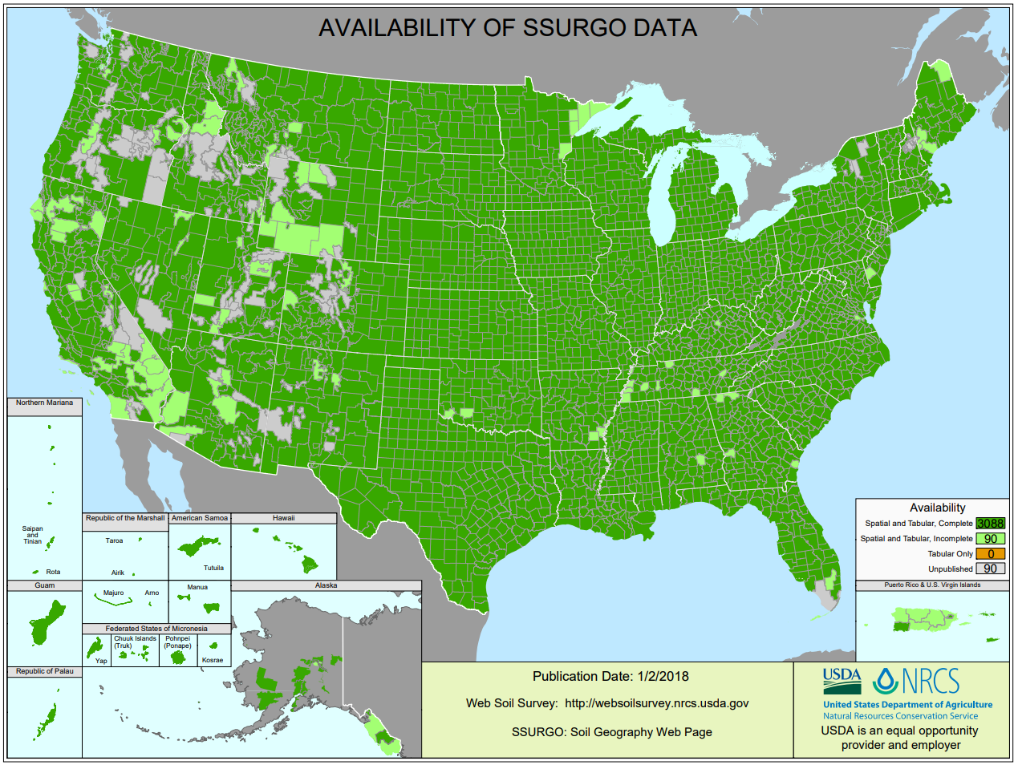
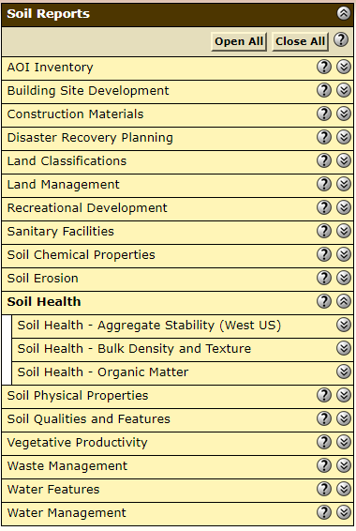
Example map of Soil Health – Organic Matter in Web Soil Survey.
New Soil Health Reports
in Web Soil Survey.
Web Soil Survey (WSS) provides soil data and information produced by the National Cooperative Soil Survey. It is operated by the USDA Natural Resources Conservation Service (NRCS) and provides access to the largest natural resource information system in the world. NRCS has soil maps and data available online for more than 95 percent of the nation’s counties and anticipates having 100 percent in the near future. The site is updated and maintained online as the single authoritative source of soil survey information.
New Soil Health Interpretations
Agricultural Organic Soil Subsidence
Suitability for Aerobic Soil Organisms
Soil is the habitat for a wide variety of organisms, ranging from viruses, bacteria, fungi, nematodes and a variety of others. Bacteria and fungi provide many services in soils. For example, bacteria convert plant and animal tissues into humus. Many of the resultant compounds bind the soil into aggregates. Bacteria may fix nitrogen for plant use and fungi assist plant roots in obtaining nutrients and water. Soil microbes are generally most abundant in the surface layer since they typically are found around plant roots. Soils vary in their ability to foster plant growth and thus also in their ability to support microbial populations. These differences can be caused by natural, inherent soil and site properties or can be the result of dynamic soil properties that are influenced by management, good or bad. Two major classifications of soil organisms are aerobic and anaerobic depending on the presence or absence of oxygen.
Soil Susceptibility to Surface Sealing
Soil Organic Matter Depletion
Organic soils used in agricultural production are subject to a loss of volume and depth of organic material due to oxidation caused by above normal microbial activity resulting from excessive water drainage, soil disturbance, or extended drought. Microbial mediated oxidation is the primary driver of volume reduction once water is removed. Soil shrinkage and compaction due to dewatering is considered to be secondary. Any drawdown resulting in water levels below soil surface can result in increased subsidence rates. The subsidence rate can also be influenced by agricultural practices. The type of tillage operation, such as plowing, disc harrowing and switch plowing, moldboard plowing increase the oxidation rate. The use of no-till practice is recommended to slow the subsidence. Any aggressive tillage measure increases microbiological activity and decreases carbon sequestration. Drainage water management can be implemented to control water tables to help slow the subsidence rate.
Surface sealing is the orientation and packing of dispersed soil particles that result from the physical breakup of soil aggregates due to rain drop impact. Rapid soil wetting (in dry soils) is another process that can cause aggregates to disperse. Sealing results when clay and silt particles get detached and/or dispersed and become suspended in the infiltrating water, which is moving downward through surface-connected pores. The pores become clogged with the fine particles and become closely packed, creating a surface seal. Surface sealing is the initial process in the formation of a mineral crust (Awadhwal and Thierstein, 1985). A soil crust is a broader term for a surface feature that is dense, hard, or restricts infiltration and can be biological or mineral. A seal is a more specific term referring to a surface layer that inhibits infiltration (Heil, 1993). Surface seals decrease infiltration rate, reduce available water to plants, diminish natural recharge of aquifers, increase runoff, and decrease crop yields (Assouline et al., 2011). Surface sealing has also been shown to be the primary cause of post-fire runoff and erosion (Larsen et al., 2007).
A fertile and healthy soil is the basis for healthy plants, animals, and humans. Soil organic matter is the very foundation for healthy and productive soils. Understanding the role of organic matter in maintaining a healthy soil is essential for developing ecologically sound agricultural practices. Perhaps just as important is identifying areas at greater risk of depleting that organic matter. The accumulation of organic matter in soil is the result of the processes that synthesize organic matter being able to generally out-produce the processes that destroy organic matter. These processes act on continental and local scales. Continental factors include the mean annual temperature which ultimately governs the rates of biological processes, both synthesizing and destroying organic matter. Another continental scale factor is the amount of moisture generally available for plants and soil microbes to use. This is governed by the amount of rainfall an area receives in relation to the potential evapotranspiration.
Criteria Table: Agricultural Organic Soil Subsidence
Criteria Table: Suitability for Aerobic Soil Organisms
Criteria Table: Soil Organic Matter Depletion
Concentration of Salts - Soil Surface
Interpretation for soil susceptibility to surface salinization
Problem – Concentration of salts on the soil surface can occur in susceptible soils due to management induced changes in the near surface hydrology of the landscape.
Criteria Table: Concentration of Salts - Soil Surface
ADD Concluding Remarks
ADD Contact info

